Slide 1
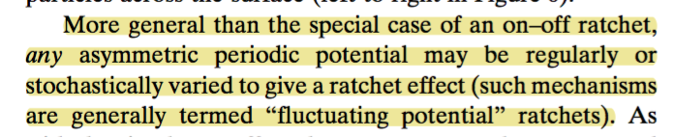
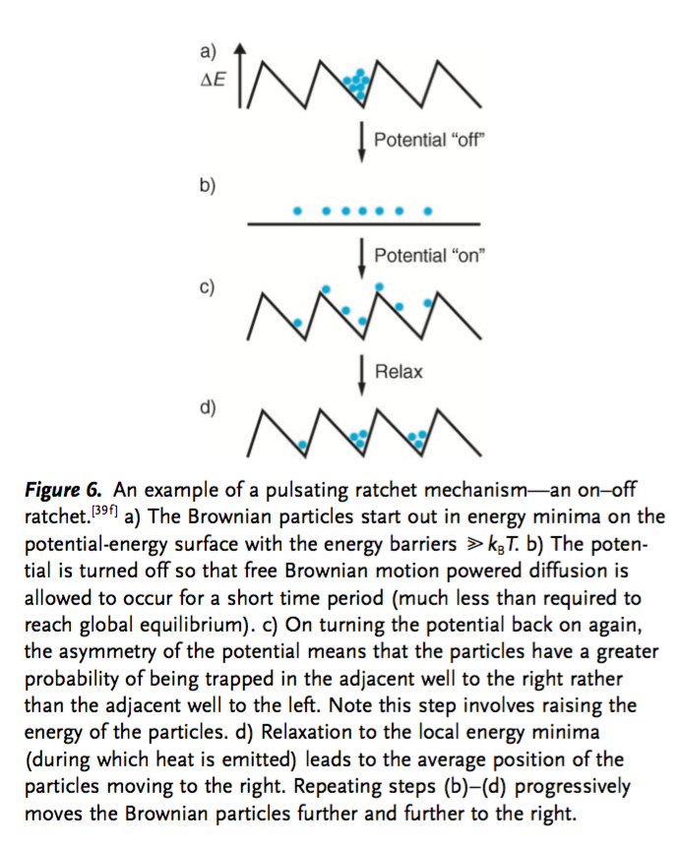
1. Kay, E. R., Leigh, D. A. & Zerbetto, F. Synthetic Molecular Motors and Mechanical Machines. Angewandte Chemie International Edition 46, 72–191 (2006).

